Slide 1
Welcome!
Question of the Day:
TBD
‹#›

Slide 2
5.1 The While Loop
5.2 The Fencepost Problem
PROFESSOR RAMSEY
GDC 6.318
ramsey@cs.utexas.edu
Notes:
provide good summary slide for int and double random numbers with all possibliities

Slide 3
Announcements
NEW Let’s Ketchup - Specialty Help Hours for

Slide 4
4.2 - 4.4 Quiz

Slide 5
Class Photo

Slide 6
Catch Up
Slides 23 - 28, printf

Slide 7
5.1
The While Loop
Notes:
Session Title: Project Based Learning (PBL) for Equity in CS classes
Session Description: If you are teaching a survey course like Computer Science Principles, or a code intensive course like AP CS A, PBL can serve as a powerful tool to increase student interest and engagement. Learn about research that connects PBL to improved student outcomes, especially for girls and underrepresented minorities. Discover available PBL resources and understand PBL lesson components, so you can build your own.

Slide 8
demo1()
What is new?
Demo

Slide 9
Types of Loops
definite loop: Executes a known number of times. Examples:
Print "hello" 10 times.
Find all the prime numbers up to an integer n.
Print each odd number between 5 and 127.
indefinite loop: One where the number of times its body repeats is not known in advance. Examples:
Prompt the user until they type a non-negative number.
Print random numbers until a prime number is printed.
Read a line from a file until there are no more lines

Slide 10
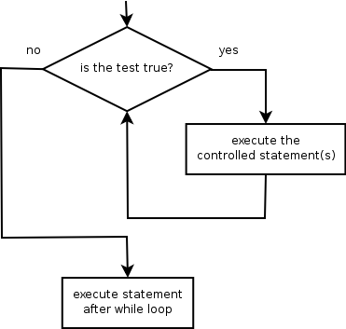
The While Loop
while loop: Repeatedly executes its body as long as a logical test is true.
while (test) {
statement(s);
}
Example:
int num = 1; // initialization
while (num <= 200) { // test
System.out.print(num + " ");
num = num * 2; // update
}
// output: 1 2 4 8 16 32 64 128

Slide 11
Demo
demo2()
A better while loop

Slide 12
Write a method called showTwos() that accepts an integer parameter and prints the factors of 2. For example, these method calls:
result in this output:
In-Class Practice

Slide 13
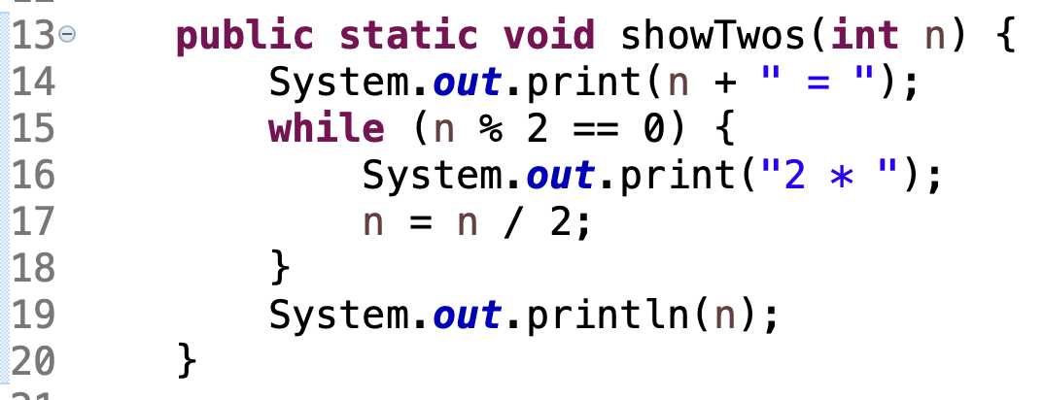
Solution

Slide 14
Sentinel Values
sentinel: A value that signals the end of user input.
sentinel loop: Repeats until a sentinel value is seen.
Example: Write a program that prompts the user for numbers until the user types 0, then outputs their sum. In this case, 0 is the sentinel value.
Enter a number (0 to quit): 10
Enter a number (0 to quit): 20
Enter a number (0 to quit): 30
Enter a number (0 to quit): 0
The sum is 60
Another type of sentinel - a soldier or guard whose job is to stand and keep watch.

Slide 15
Demo
Trouble with the sentinel
demo3a()
See next slide.
demo3B()

Slide 16
The Problem
Our code uses a pattern like this:
sum = 0
while (input is not the sentinel) {
prompt for input; read input
add input to the sum
}
On the last pass, the sentinel -1 is added to the sum:
prompt for input; read input (-1)
add input (-1) to the sum

Slide 17
Solution

Slide 18
Demo
Another indefinite loop option
demo4()

Slide 19
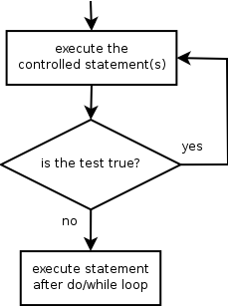
Do While Loop
do/while loop: Performs its test at the end of each repetition.
Guarantees that the loop's {} body will run at least once.
do {
statement(s);
} while (test);
// Example: prompt until correct password is typed
String phrase;
do {
System.out.print("Type your password: ");
phrase = console.next();
} while (!phrase.equals("abracadabra"));

Slide 20
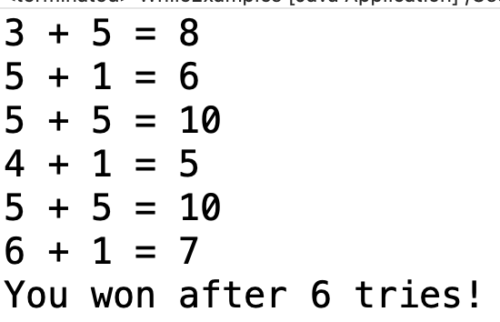
Write a method called rollDice() that uses Math.random() to simulate rolling two die and print the result of the roll. It will continue to roll the die and print until the sum of the two die equals 7. Then, it prints the number of tries it took to get the sum of 7. Use a Do While loop. Example output:
In-Class Practice

Slide 21
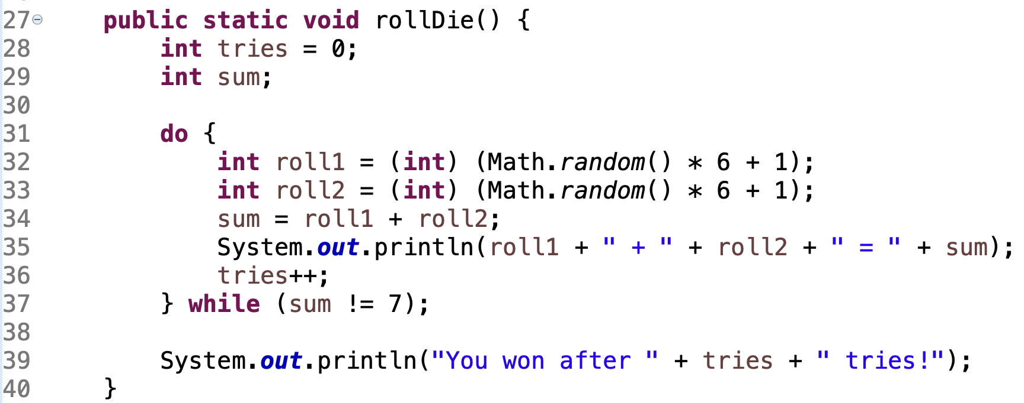
Solution

Slide 22
5.2
The Fencepost Problem
Notes:
Session Title: Project Based Learning (PBL) for Equity in CS classes
Session Description: If you are teaching a survey course like Computer Science Principles, or a code intensive course like AP CS A, PBL can serve as a powerful tool to increase student interest and engagement. Learn about research that connects PBL to improved student outcomes, especially for girls and underrepresented minorities. Discover available PBL resources and understand PBL lesson components, so you can build your own.

Slide 23
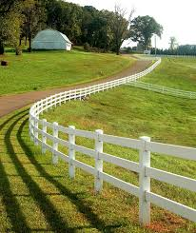
The Fencepost Problem
I’m going to build a fence using this loop:
while not done
build a post
attach boards across
last set of boards will fall down

Slide 24
The Fencepost Fix
build first post
while not done
build a post
attach boards across

Slide 25
For this method:
and method call:
the output is:
Rewrite the method to get this output instead:
In-Class Practice

Slide 26
Solution

Slide 27
Remember
You Belong Here
TBD
Hi!

